Slide 1

Bangladesh Higher Education Summit 2022
Envisioning Quality Higher Education for Everyone Who Seeks It

Slide 2
Bangladeshi 104 Private Universities under one roof
Country’s Largest Exhibition on Education and Education Supporting Industries. We will engage all the private universities in Bangladesh. This fair will provide a unique opportunity for all higher education related stakeholders in Bangladesh. it will be the platform for students, faculty members, education entrepreneurs, investors, policy makers, industry leaders, and visionaries/dreamers. The event will be presented through thought leadership talks, panel discussions, youth testimonials, and multiple exhibitions.

Slide 3

Program Date & Duration
Date: November 9-10-11, 2022 Duration: 3 Days ( 10.00am-08.00pm)

Slide 4
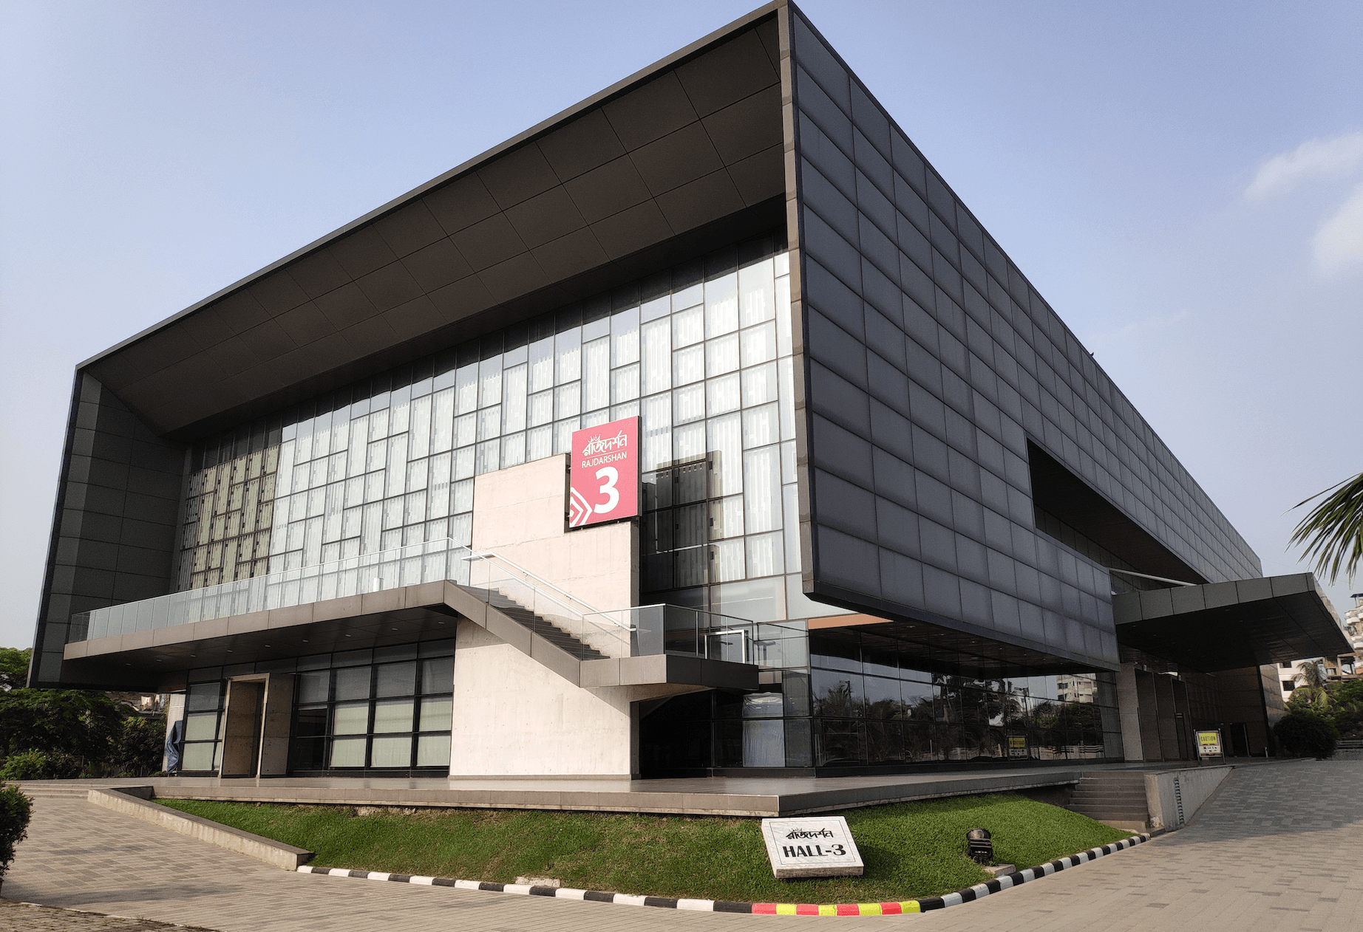
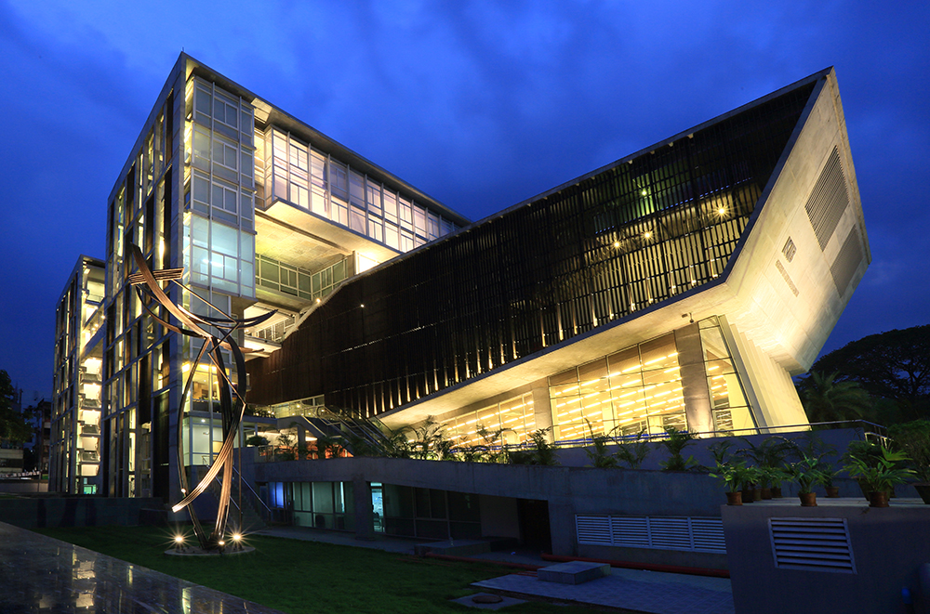
Venue: ICCB or KIB Dhaka

Slide 5
Program Details
Program nature:
Chain Program Online (Yearlong)
Program Type:
Educational Event
Programs participants:
Educational Institution
Bank and Financial Organization
Education Supporting Industries
HR Specialists
Targeted audience:
Students,
Guardians,
Faculty members,
Educationalists,
Investors,
Policymakers,
industry leaders, and
Visionary persons.

Slide 6



Our Mission
To develop academia-industry relationship & create direct proper communication between prospective learners and the universities
To promote the prospects and to explore the opportunity of Education loan/Education banking for higher education at home or abroad.
To create learning and business opportunities for students, faculty, institution-owners and EdTech companies, and to create network among them

Slide 7
Our Vision
104 private university in one place with financial organizations & education supporting industry
Establishing a quality full admission process & provide valuable information, along with scholarships
Create a complete eco-system of higher education seekers & providers (private) end to end to support youth

Slide 8


Registration Process
Online
Offline
Participants and Visitor can do Registration in online
Participants and Visitor can do Registration in offline
Registration Fees for the participating organizations: BDT 1,00,000/-
Registration for the youth is Free of Cost

Slide 9

Registration & Bookings Details
Our team will go to the Universities & companies to register. They will convince about the event. Benefits for the universities and other participants.
Our online registration and bookings procedure will be open and also communication via mail.
A decorated stall with Electricity and air condition facilities.
Every registered university will get other associated facilities ( details will be given via mail after registration)

Slide 10

University & Sponsors’ Benefits
Branding facilities start from registration to gate, banners, and the print media
A Large number of College students’ and guardians’ engagement
We will promote all the registered universities and sponsors on social media and digital marketing promotion
Universities will get the opportunity of branding with some specific colleges in their vicinity

Slide 11
Higher Education Seekers’ Benefits
Will find most of the universities, banks & IT Products in one place
Getting easy Scholarship/ Waiver/Discount in admission
Financial support and motivation through skill development seminars, Workshop & Proper counseling
A proper idea about all the university education facilities & systems

Slide 12

Sponsors’ Benefits
Distinctive print media (newspaper) visibility
Will find a large number of their target people
As our program is a year-long chain program, our sponsoring partners will be promoted all over the year online
Fully developed sponsor zone & venue benefits

Slide 13



Program Activities & Rundown Planning
Educational & Motivational Seminars for the invited students
Information sessions from Universities, financial support options & educational investors, including EdTech meets
Digital & Smart Educational Workshop for the students
Skill development seminars & exposure to specific domains

Slide 14

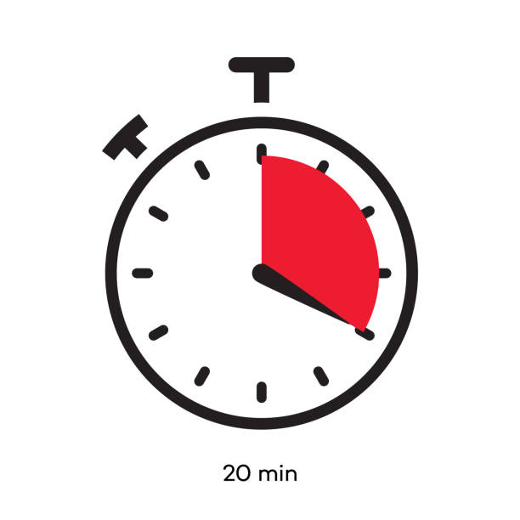

Supportive Programs
Waivers/ Scholarships/ Discounts in Admissions & on the spot selection, Psychometric Tests
Each university will get a specific time slot to show its activities, systems & achievements to connect to the students & guardian
Showing different documentaries & glimpses of various universities & other sponsors

Slide 15
Closing programs
Prize giving ceremony for the best admission confirming universities, & some others
Raffle draw, students fun & learn games, quiz competition, JAM Sessions
One Concert & cultural performances from the universities interested

Slide 16
Marketing Tools
ONLINE
WEBSITE
MEDIA
ELECTRONIC MEDIA
OFFLINE
BANNERs
ON GROUND
Contests among youths
YOUTUBE CHANEL
FACEBOOK PAGE
INSTAGRAM PAGE
OTHER SOCIAL MEDIA PAGES
TV & Radio Channels
SOCIAL MEDIA
Facebook
YouTube
Instagram
Blogspot
PRINT MEDIA
Some leading newspapers
FESTOON
LEAFLETs
OUT OF HOME
School-based mass participation

Slide 17

Outcomes
Mass Promotion
Mass Admission
University Attendance
Linkage and Networking with Industry and Participants
Opportunity creation for the University, Students and Industry
CV Bank
Participants Data Base
Student Job Opportunity
Investment Opportunity
Market Creation and Development
Sponsor Investment

Slide 18
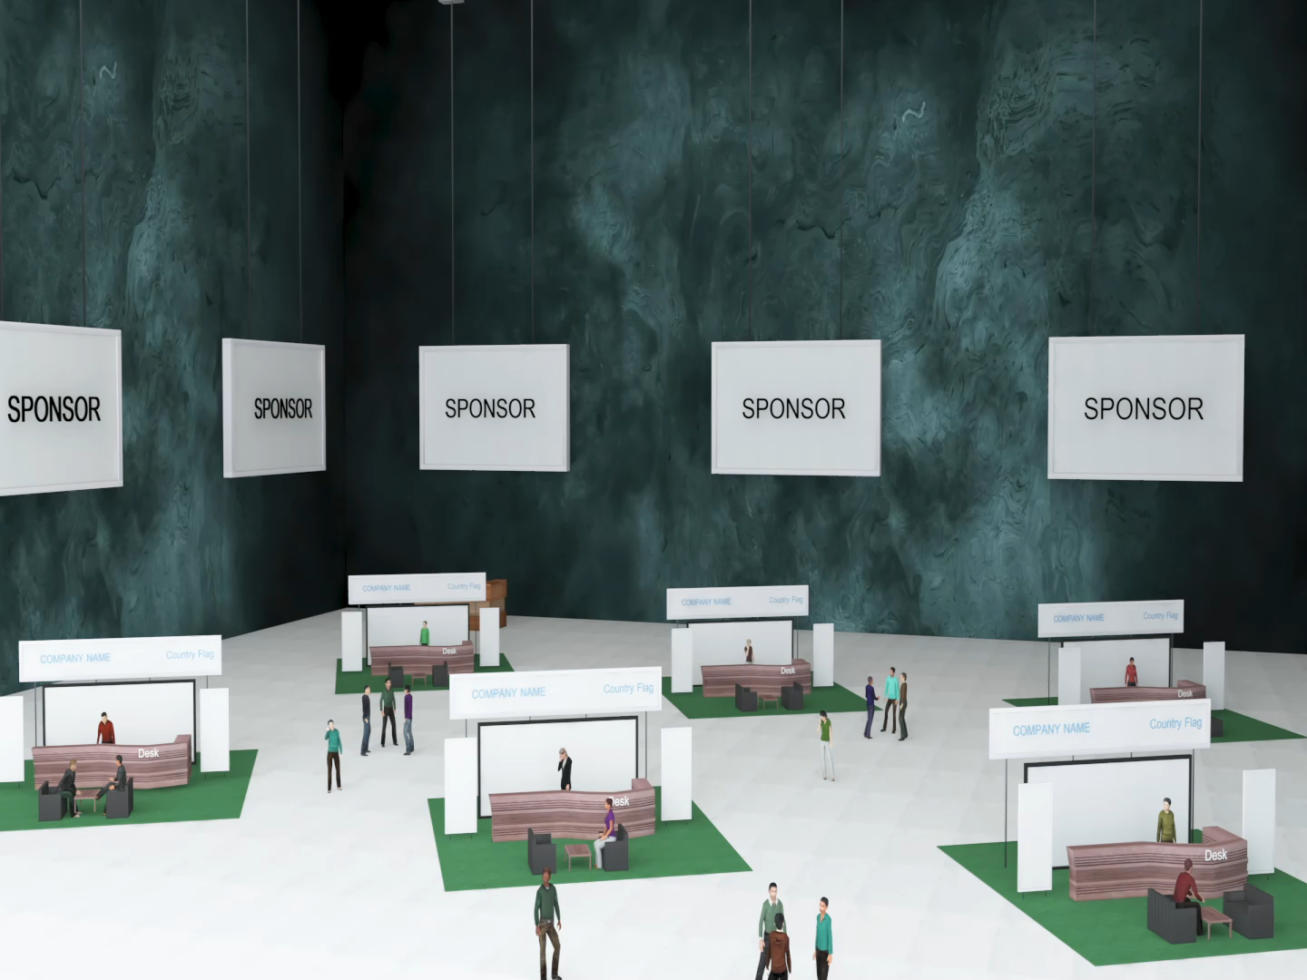
Virtual Platform

Slide 19
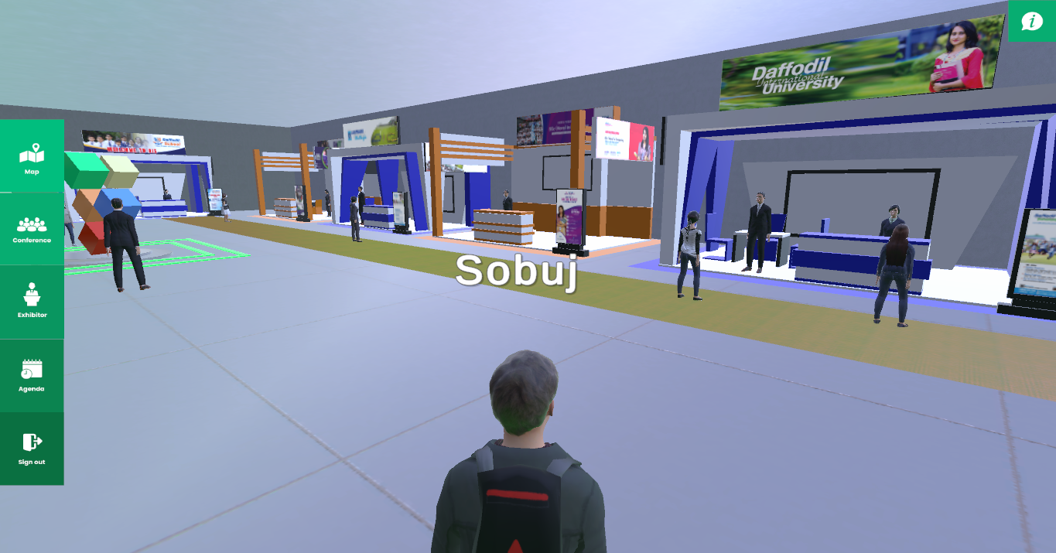
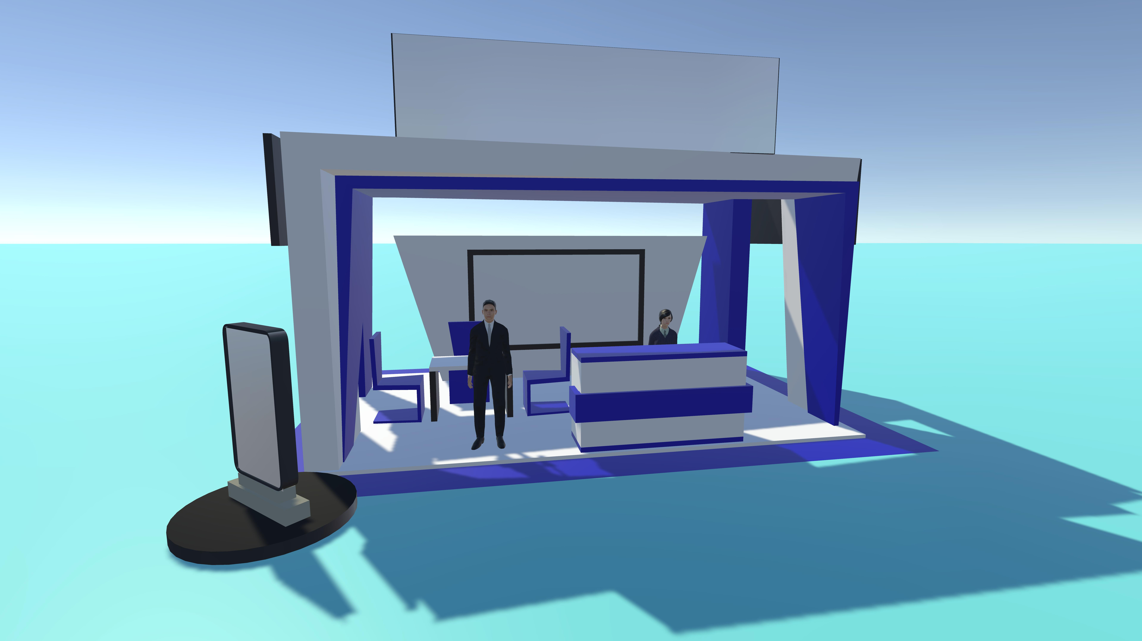
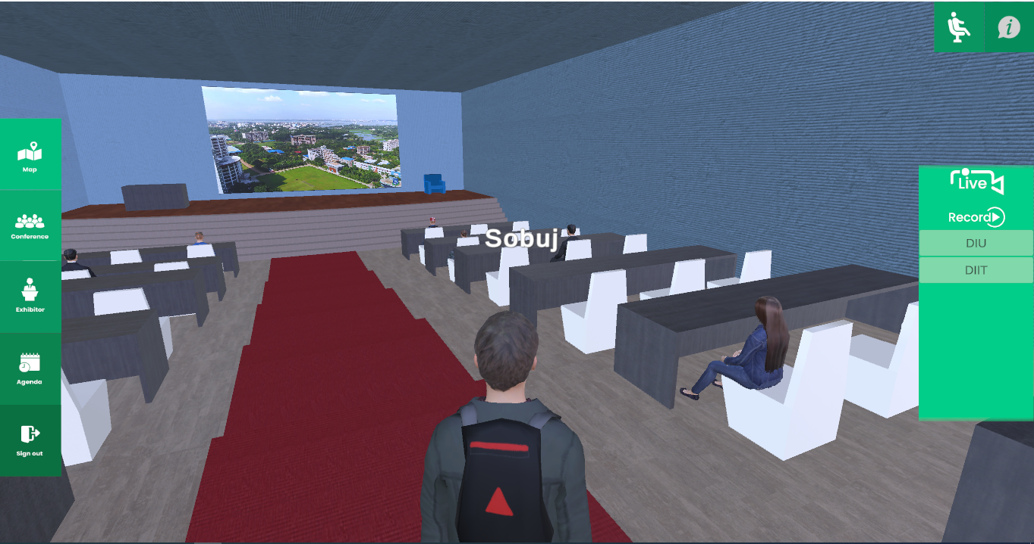

Slide 20
Virtual Platform Features
Environment Development: 2D or 3D Environment design is like a real venue with all kinds of Branding and promotion. The exhibition hall and conference hall will be designed by venue structure.
Exhibitor Stall decoration and placement: Each and every exhibitor get an individual stall. And Every Stall has the facility to Showcase its Company information, art, design, and service. Every Stall has a video and Audio-conferencing facility.
Participation Registration and Others: One easiest registration system will generate. Each and every participant doing registration for data collecting.
Data Management: For developing the Virtual Platform will use strong backend software. Where all the data will be stored and preserved in full secure management.
Online Participation: For Developing a Virtual Platform for this event anyone can join from any whare of the world avoiding any kind of physical and online hassle. It will be time-consuming.

Slide 21
Benefits of using Virtual Platform
Will Get One Virtual Platform which is developed as like venue environment
Anyone can join from anywhere in the world
Time-Consuming for the exhibitor and participants
People can visit exhibitions from anywhere in the world and anytime
Using storm backend solution for the event management
Using the easiest online registration system
Data Management and Secure data
Get everyday information and reporting from the system
Light Platform
May get exhibitors from the international market.
B2B & B2C placement and meeting solution
Each and every event can be live telecast through this platform
U2S (University to Student) Solution Integration.

Slide 22
Why Join this event
The full event will be organized Physically and Virtually
Virtual Platform will be a 3D Environment that is giving physical feelings
Main Event will be going 3 Day based but We will provide 15 Day event through Virtually
The Virtual Platform will be active next 15 days
International students will be joining this event through Virtually
Each and every university will get a single pavilion Physically and Virtually

Slide 23

THANK YOU!

